Slide 1
Naukri FastForward Privilege Report Generation App
by
Prithwiraj Samanta
Under the supervision of
Dr. Rashmi Panda
Department of Computer Science and Engineering
INDIAN INSTITUTE OF INFORMATION TECHNOLOGY, RANCHI
(An Institution of National importance under act of Parliament)
(Ranchi - 834010), Jharkhand

Slide 2
Project Details
Student Details
Name | PRITHWIRAJ SAMANTA
Registration Number | 2018UGCS002R | Roll No | CSE/02
Email Address | psamanta.btech.cs18@iiitranchi.ac.in | Phone No (M) | 6204570243
Project Details
Project Title | FastForward Privilege Report Generation
Project Duration | 6 months (approx.) | Date of reporting | 3 Jan 2022
Organization Details
Organization Name | InfoEdge India Limited
Designation | Software Development Intern
Full postal address | Info Edge (India) Limited, B - 8, Sector - 132, Noida - 201304, India
Website address | http://www.infoedge.in/
Supervisor Details
Supervisor Name | Dr Rashmi Panda
Designation | Assistant Professor (ECE Department)
Full contact address | IIIT Ranchi, Science and Technology Campus, Namkum, Ranchi - 834010
Email address | rashmipanda@iiitranchi.ac.in | Phone No (M) | 9861144096

Slide 3
Outline
Introduction ……………………………………………………….. 4
Motivation ……………………………………………………….. 5
Methodology ……………………………………………………….. 6
Implementation ……………………………………………………….. 9
Result and Analysis ……………………………………………………….. 17
Conclusion ……………………………………………………….. 18
Future Work ……………………………………………………….. 19
App Demonstration during presentation of Result and Analysis

Slide 4
Introduction
The FastForward team of naukri.com generates a report for a paid users.
It contains statistical data that helps the user to understand the current job market trends, and competition at his/her level.
This report is generated manually for each user so it takes a large amount of time and labour.
The report is generated monthly so it does not have daily-updated statistics.

Slide 5
Motivation
The project automates the entire report generation process, saving time and labour..
It provides the user with report generation facility in form of an app that runs on Android, IOS, and Web.
It will allow the user to generate the report at their will any number of times with updated trends within seconds.
This app will gather data from various sources and display it to a user.
This app will also act as an advertising point for other Naukri services.

Slide 6
Methodology
Aspect | Flutter | React-Native
What is it? | Portable UI Toolkit | Framework
Official release | December 2018 | March 2015
Created by | Google | Facebook
Free and open source | Yes | Yes
Programming language | Dart | JavaScript
Popularity | 136K stars | 101K stars
Hot Reload | Yes | Yes
Native performance | Great | Great
UI | Looks same on all | Looks adjust according to platform
Sharing code | All platforms | Mainly IOS & Android
Top apps made with this | Musical, Google Ads, My BMW | Instagram, Facebook, Skype

Slide 7
Methodology
Aspect | Flutter | React-Native
Time-to-market | Very fast | Fast
Effort | Less | More
Stability | Stable | Stable
Maintenance | Easy to maintain | Lots of dependency issues
Competitive advantage | Rich Widget Library Rapidly growing community Excellent documentation | Many successful market players Mature, vast community Easy to learn
When it is not used | App needs 3D Touch App design is platform specific App requires multiple OS interaction | App needs to handle background tasks Require Bluetooth communication

Slide 8
Methodology
Why we chose Flutter?
We are creating a new application with fastest development speed possible.
Flutter provides built-in support of responsive UI along with large library of predefined widgets optimized for performance.
There are library available for creating graphs and charts as well as PDFs.
We can event draw out any custom widgets using different mathematical curves.
Its dependencies are auto-managed, and can be upgraded easily

Slide 9
Implementation
Data Flow in the Application
State Management
Ephemeral State
Ephemeral state (sometimes called UI state or local state) is the state one can neatly contain in a single widget.
Other parts of the widget tree seldom need to access this kind of state. There is no need to serialize it, and it doesn’t change in complex ways.
In other words, there is no need to use state management techniques on this kind of state. All one need is a StatefulWidget.

Slide 10
Implementation
2. App State
State that is not ephemeral, that you want to share across many parts of one’s app, and that you want to keep between user sessions, is what we call application state (sometimes also called shared state
For managing app state, one will want to research one’s options. One’s choice depends on the complexity and nature of one’s app, one’s team’s previous experience, and many other aspects.

Slide 11
Implementation
Classes & Widget for State Management
ChangeNotifier Class
ChangeNotifier is a simple class included in the Flutter SDK which provides change notification to its listeners.
In other words, if something is a ChangeNotifier, you can subscribe to its changes.
ChangeNotifierProvider Widget
ChangeNotifierProvider is the widget that provides an instance of a ChangeNotifier to its descendants.

Slide 12
Implementation
3. Consumer Widget
Consumer is the widget that allows its descendent to subscribe and listen to the events of ChangeNotifier Object.
4. SharedPreference Class
Wraps platform-specific persistent storage for simple data.
Data may be persisted to disk asynchronously, and there is no guarantee that writes will be persisted to disk after returning.

Slide 13
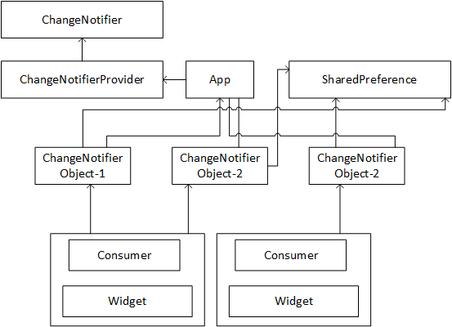
Methodology
How State is managed in the application?

Slide 14
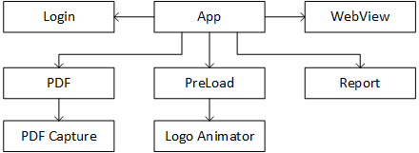
Implementation
Components in the Application

Slide 15
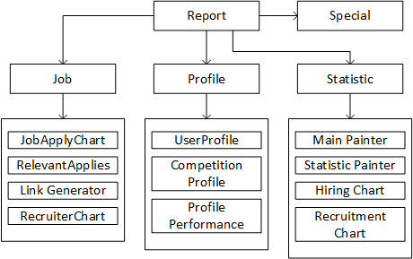
Implementation

Slide 16
Implementation
Explanation
App Component has Navigation Controller which controls the navigation of screens-Login, PDF, Preload, Report, and WebView.
Report has BottomNavigation Controller which controls the tabs-Job, Profile, Special, and Statistic
Report also has a controller for Sidebar(Sidebar Component not shown in diagram)

Slide 17
Result and Analysis
We have created the Graphical User Interface of the application strategically so that users can view important statistics at first.
There are warning present in the application that is due to null-safety of flutter.
We can assure you that it will not affect the performance and user experience.
Our application may experience a few bugs as it is still in the testing phase, which will be solved gradually with updates.

Slide 18
Conclusion
We have created an application that is capable of running across three platforms- Android, IOS, and Web.
We have tried our best to create a Graphical User Interface with the highest possible optimization and smallest response time possible.
We have packed the application with a lot of statistical data to help them in finding their dream job.
We have developed a PDF engine for creating a beautiful PDF of all the statistics shown in the application.

Slide 19
Future Work
In Future, we will be adding more statistical data to the application when it will be available.
We will be enhancing the PDF engine to create a more beautiful and realistic PDF.
We are currently working on the integration of the Do-Select platform with our app to provide skill and aptitude tests for users.
It will be soon released in an upcoming feature update.

